Slide 1
RED-BLACK TREE

Slide 2

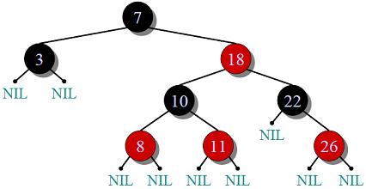
Definition
Red-Black Tree is a self-balancing Binary Search Tree (BST) where every node either having red color or black color

Slide 3
Rules For RED-BLACK Tree
Red-Black Tree is a self-balancing Binary Search Tree (BST) where every node follows following rules.
Every node has a color either red or black.
Root of tree is always black.
There are no two adjacent red nodes (A red node cannot have a red parent or red child).
Every path from a node (including root) to any of its descendant NULL node has the same number of black nodes.

Slide 4
Why Red-Black Trees?
Most of the BST operations (e.g., search, max, min, insert, delete.. etc) take O(h) time where h is the height of the BST. The cost of these operations may become O(n) for a skewed Binary tree.
If we make sure that height of the tree remains O(Logn) after every insertion and deletion, then we can guarantee an upper bound of O(Logn) for all these operations. The height of a Red-Black tree is always O(Logn) where n is the number of nodes in the tree.

Slide 5
AVL Tree Disadvantage
The AVL trees are more balanced compared to Red-Black Trees, but they may cause more rotations during insertion and deletion. So if your application involves many frequent insertions and deletions, then Red Black trees should be preferred. And if the insertions and deletions are less frequent and search is a more frequent operation, then AVL tree should be preferred over Red-Black Tree.

Slide 6
How does a Red-Black Tree ensure balance?
A simple example to understand balancing is, a chain of 3 nodes is not possible in the Red-Black tree. We can try any combination of colours and see all of them violate Red-Black tree property.

Slide 7
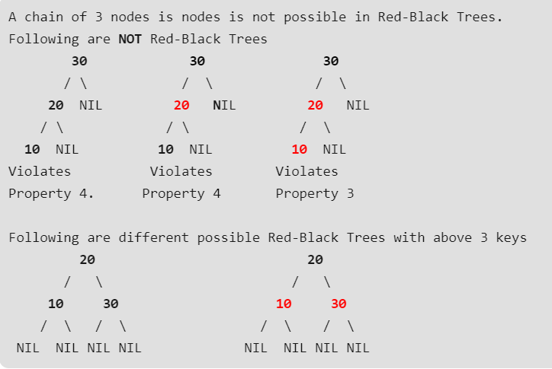
Example

Slide 8
Continue. . .
Black Height of a Red-Black Tree :
Black height is number of black nodes on a path from root to a leaf. Leaf nodes are also counted black nodes. From above properties 3 and 4, we can derive, a Red-Black Tree of height h has black-height >= h/2.
Number of nodes from a node to its farthest descendant leaf is no more than twice as the number of nodes to the nearest descendant leaf.

Slide 9
Continue . . .
Every Red Black Tree with n nodes has height <= 2Log₂(n+1)
This can be proved using following facts: 1) For a general Binary Tree, let k be the minimum number of nodes on all root to NULL paths, then n >= 2^{k} – 1 (Ex. If k is 3, then n is atleast 7).
This expression can also be written as k <= Log₂(n+1)
2) From property 4 of Red-Black trees and above claim, we can say in a Red-Black Tree with n nodes, there is a root to leaf path with at-most Log₂(n+1) black nodes.

Slide 10
Continue. . .
3) From property 3 of Red-Black trees, we can claim that the number black nodes in a Red-Black tree is at least ⌊ n/2 ⌋ where n is the total number of nodes.
From above 2 points, we can conclude the fact that Red Black Tree with n nodes has height <= 2Log₂(n+1)

Slide 11
Red-Black Tree -Insertion
In AVL tree insertion, we used rotation as a tool to do balancing after insertion caused imbalance. In Red-Black tree, we use two tools to do balancing.
1) Recoloring 2) Rotation
We try recoloring first, if recoloring doesn’t work, then we go for rotation. Following is detailed algorithm. The algorithms has mainly two cases depending upon the color of uncle. If uncle is red, we do recoloring. If uncle is black, we do rotations and/or recoloring.
Color of a NULL node is considered as BLACK.

Slide 12
Continue. . .
Let x be the newly inserted node. 1) Perform standard BST insertion and make the color of newly inserted nodes as RED.
2) If x is root, change color of x as BLACK (Black height of complete tree increases by 1).
3) Do following if color of x’s parent is not BLACK and x is not root. ….a) If x’s uncle is RED (Grand parent must have been black from property 4) ……..(i) Change color of parent and uncle as BLACK. ……..(ii) color of grand parent as RED. ……..(iii) Change x = x’s grandparent, repeat steps 2 and 3 for new x.

Slide 13
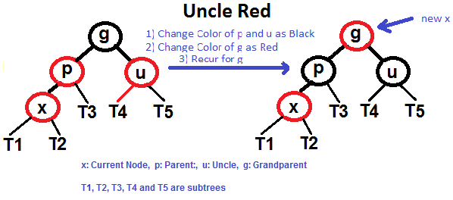
Continue . . .

Slide 14
b) If x’s uncle is BLACK, then there can be four configurations for x, x’s parent (p) and x’s grandparent (g) (This is similar to AVL Tree) ……..i) Left Left Case (p is left child of g and x is left child of p) ……..ii) Left Right Case (p is left child of g and x is right child of p) ……..iii) Right Right Case (Mirror of case i) ……..iv) Right Left Case (Mirror of case ii)
Following are operations to be performed in four subcases when uncle is BLACK.
All four cases when Uncle is BLACK

Slide 15
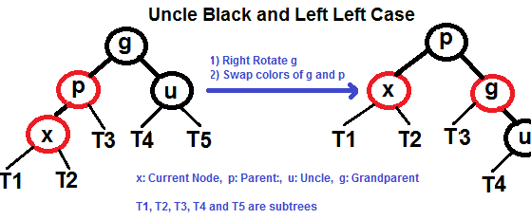
Left Left Case (See g, p and x)

Slide 16
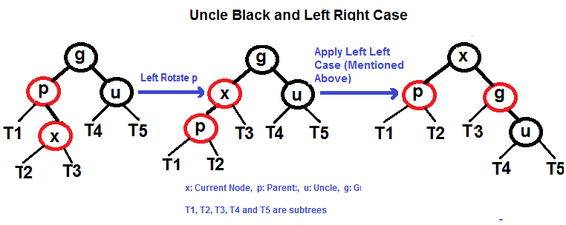
Left Right Case (See g, p and x)

Slide 17
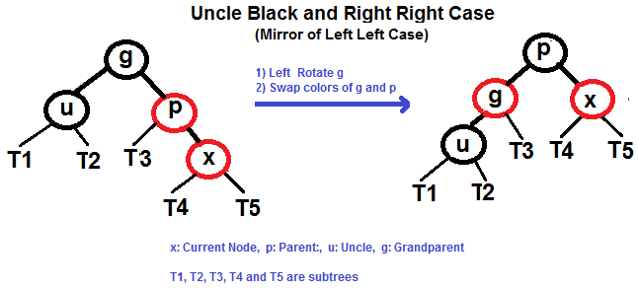
Right Right Case (See g, p and x)

Slide 18
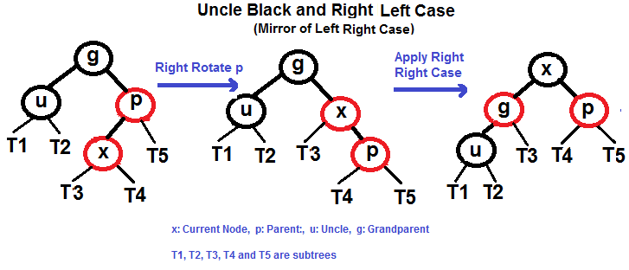
Right Left Case (See g, p and x)

Slide 19
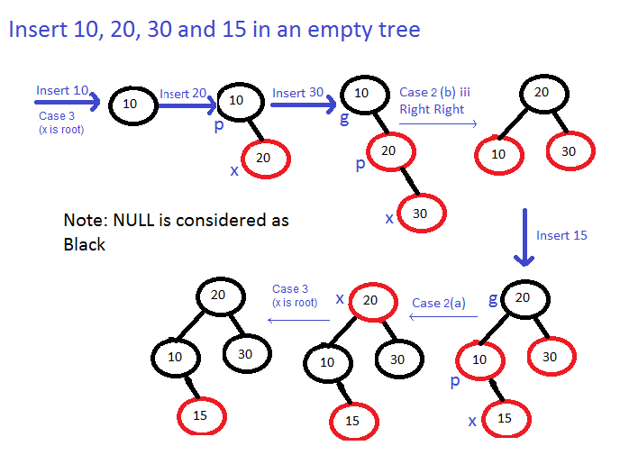
Examples of Insertion

